Slide 1
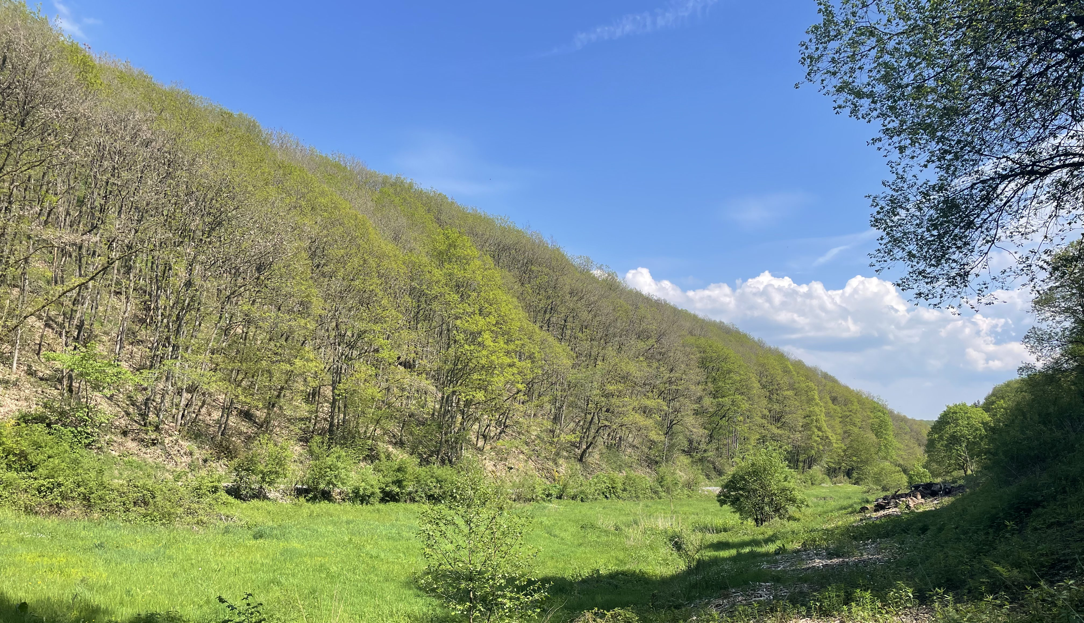

Particle filtering in discharge modelling
AESM5210C - David Haasnoot

Slide 2
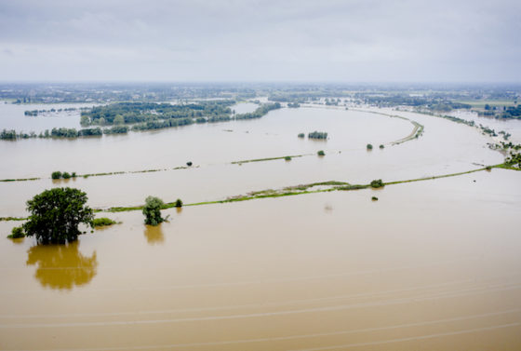
Why model catchments?
Describe in the system
Predict the hydrological response
Test potential scenarios in systems affected by climate change
Photo: Sem van der Wal ANP

Slide 3
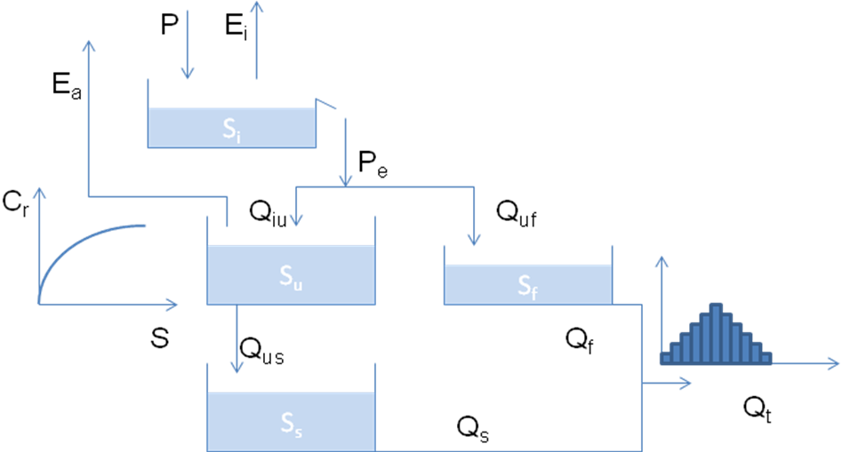

Model
Ep
HBV
Input: P, Ep(T)
Output:
Q
Parameters:
$I_{max}, C_{e}, S_{u,max}, β, P_{max}, T_{lag}, K_{f} \& K_{s}$

Slide 4
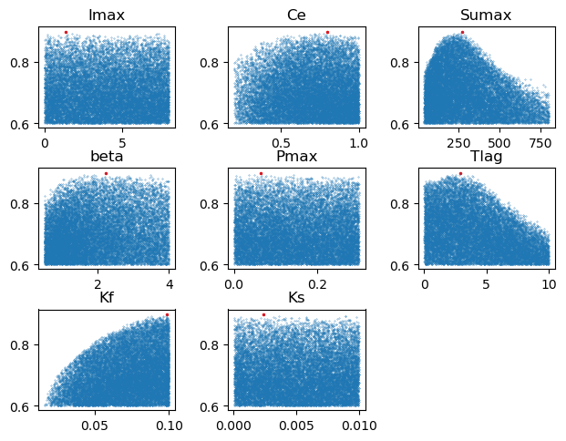
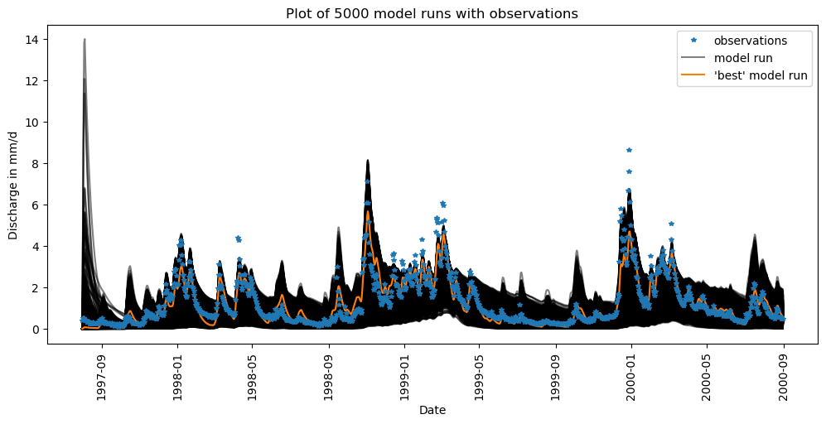

Current approach: brute force
$NSE=1−\frac{\sum_{t=1}^{T}{{\left(Q_{o}^{t}−Q_{m}^{t}\right)}^{2}}}{\sum_{t=1}^{T}{{\left(Q_{o}^{t}−\overline{Q_{o}}\right)}^{2}}}$.
NSE = 0.85

Slide 5
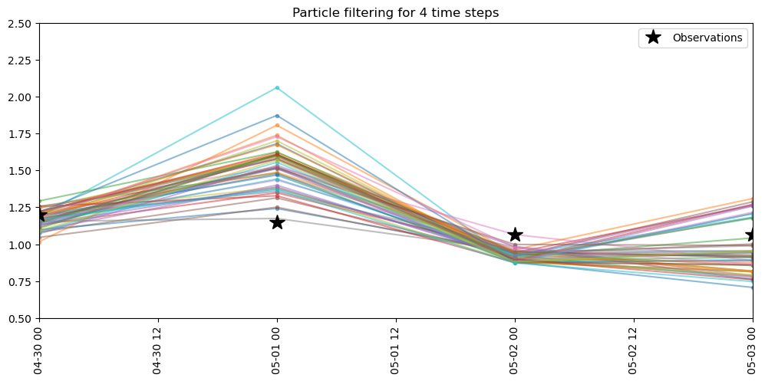
Particle filtering - implemenatation
Run model forward
Compute likelihood for each particle
Resample particles based on likelihood
Add noise to samples
Run model forward with new state vector

Slide 6
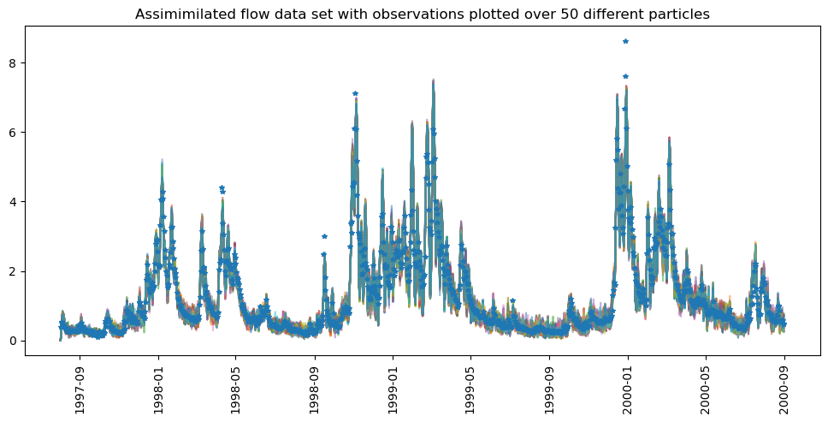

Particle filtering - results

Slide 7
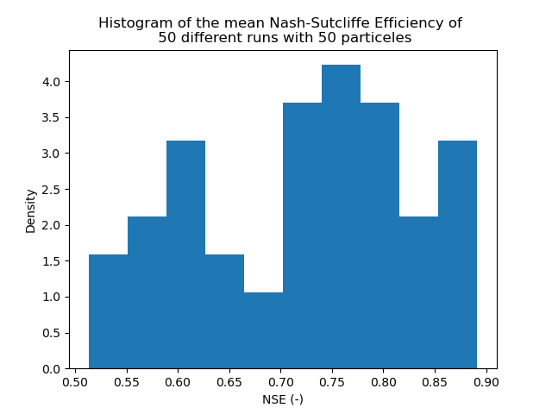
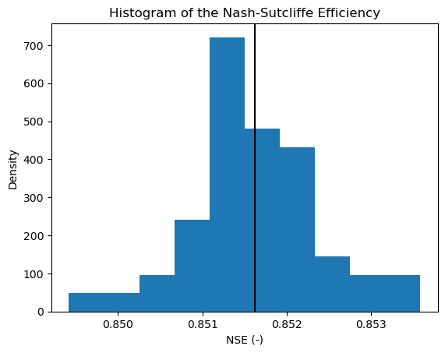
Improvements - NSE

Slide 8
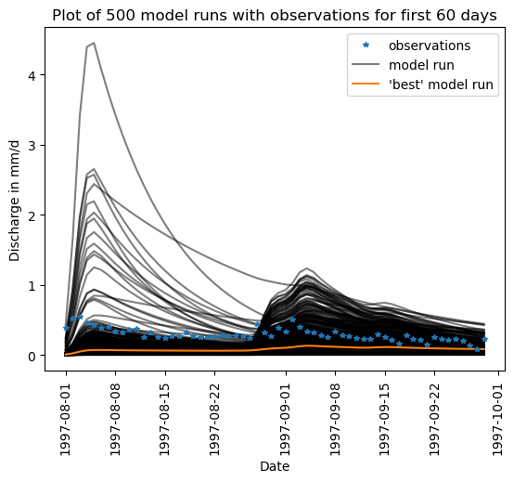
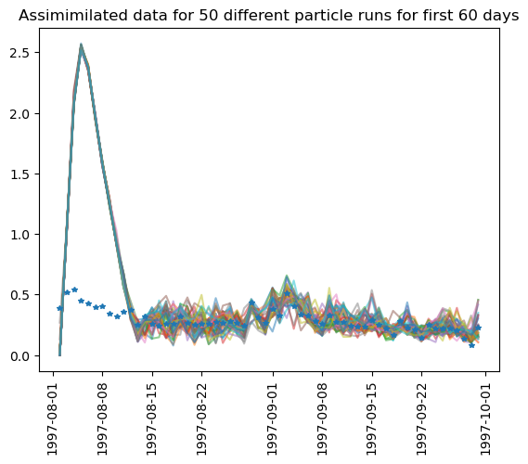
Improvements – spin up time

Slide 9
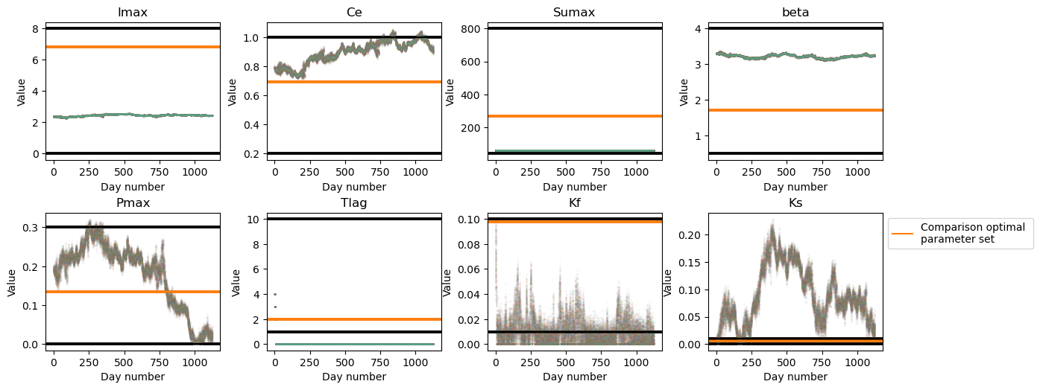
Discussion – parameters over time

Slide 10
Questions?

